Slide 1
ggplot2: Introduction and exercises
Umer Zeeshan Ijaz
http://userweb.eng.gla.ac.uk/umer.ijaz

Slide 2
Motivation

Slide 3
NMDS plot
(NMDS.R)

Slide 4
CCA plot
(CCA.R)

Slide 5
Richness plot
(richness.R)

Slide 6
Heatmap
(heatmap.R)

Slide 7
ggplot2 basics ggplot_basics.R

Slide 8
ggplot2
Use just qplot(), without any understanding of the underlying grammar
Theoretical basis of ggplot2: layered grammar is based on Wilkinson’s grammar of graphics (Wilkinson, 2005)

Slide 9
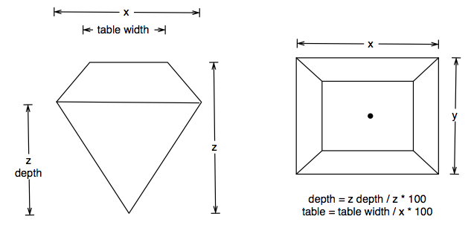
Data
head(diamonds)
A dataset containing the prices and other attributes of almost 54,000 diamonds.
The variables are as follows:
# price = price in US dollars ($326–$18,823)
# carat = weight of the diamond (0.2–5.01)
# cut = quality of the cut (Fair, Good, Very Good, Premium, Ideal)
# colour = diamond colour, from J (worst) to D (best)
# clarity = a measurement of how clear the diamond is (I1 (worst), SI1, SI2, VS1,
# VS2, VVS1, VVS2, IF (best))
# x = length in mm (0–10.74)
# y = width in mm (0–58.9)
# z = depth in mm (0–31.8)
# depth = total depth percentage = z / mean(x, y) = 2 * z / (x + y) (43–79)
# table = width of top of diamond relative to widest point (43–95)

Slide 10
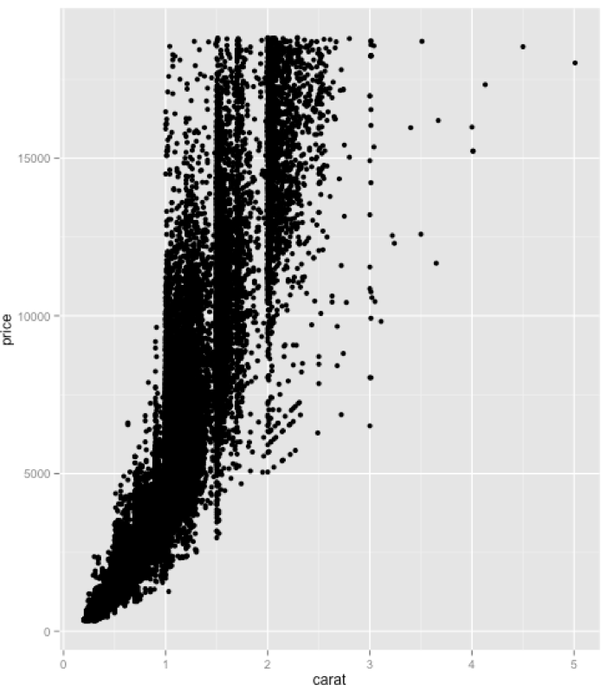
qplot(carat, price, data = diamonds)

Slide 11
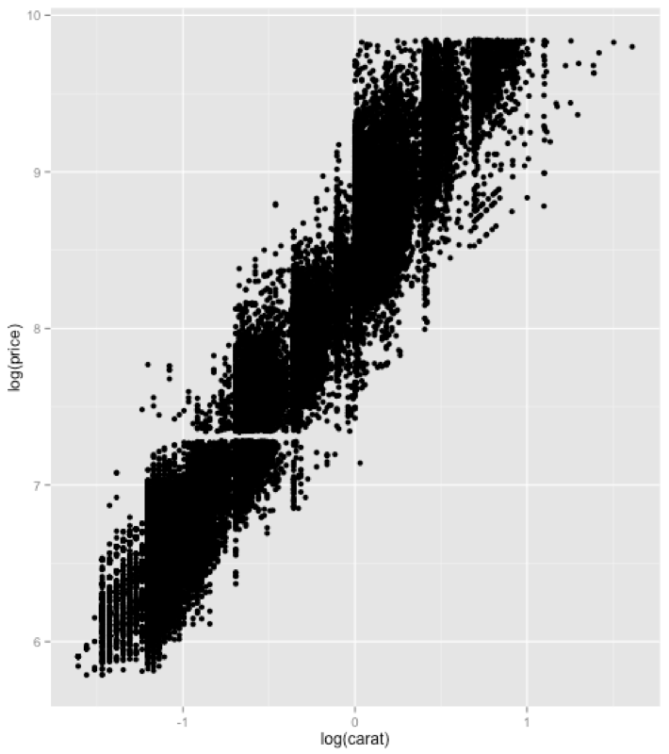
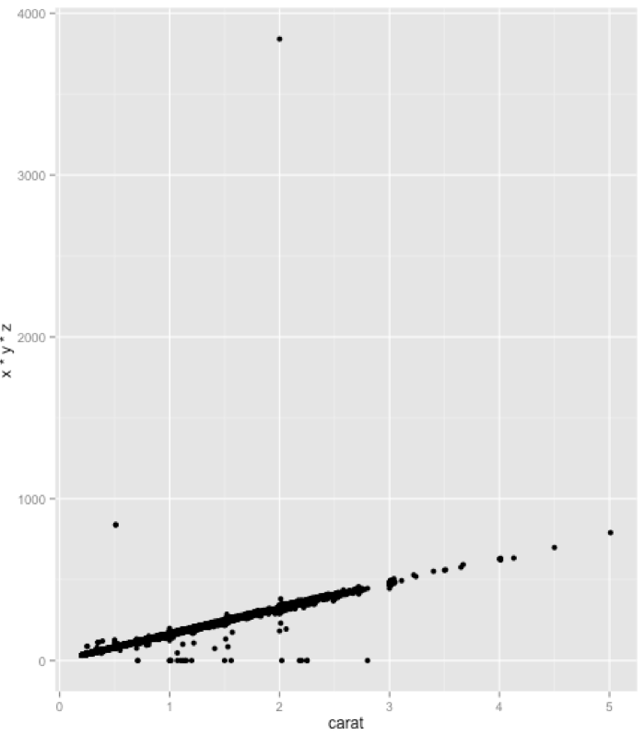
qplot(log(carat), log(price), data = diamonds)
qplot(carat, x * y * z, data = diamonds)

Slide 12
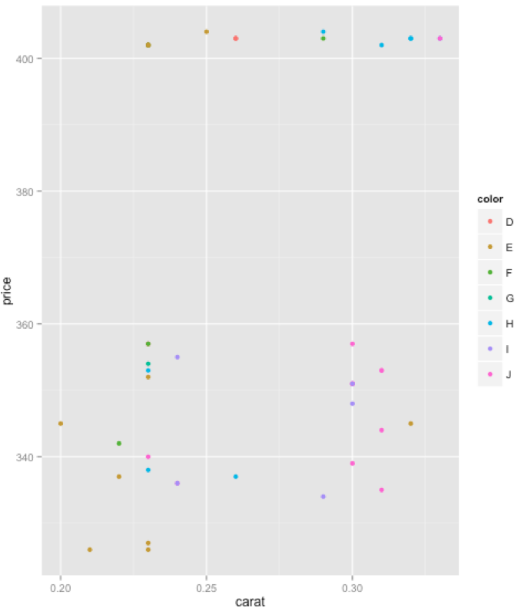
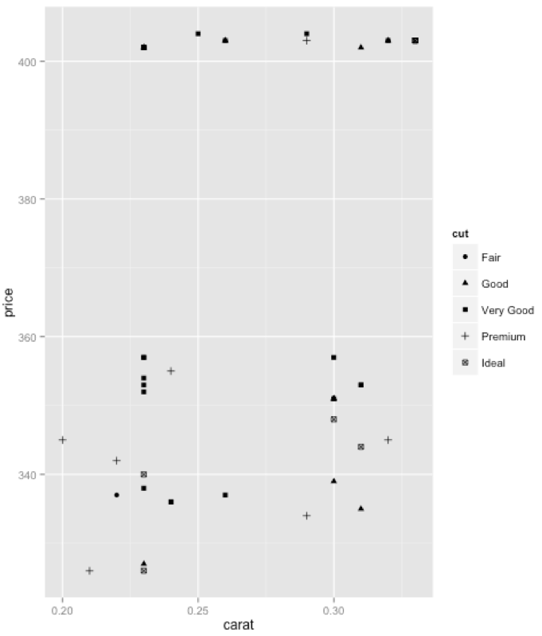
Aesthetic Attributes
qplot(carat, price, data = diamonds[1:50,], colour = color)
http://www.handprint.com/HP/WCL/color7.html
qplot(carat, price, data = diamonds[1:50,], shape = cut)

Slide 13
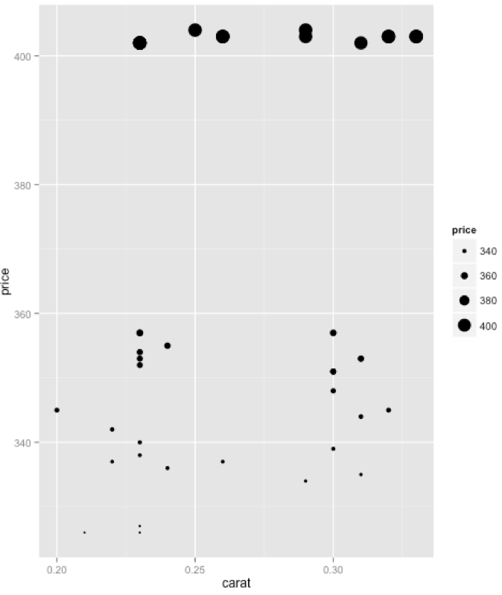
Aesthetic Attributes (3)
qplot(carat, price, data = diamonds[1:50,], size = price)

Slide 14
Aesthetic Attributes (3)
colour, size and shape are all examples of aesthetic attributes, visual properties that affect the way observations are displayed.
For every aesthetic attribute, there is a function, called a scale, which maps data values to valid values for that aesthetic.

Slide 15
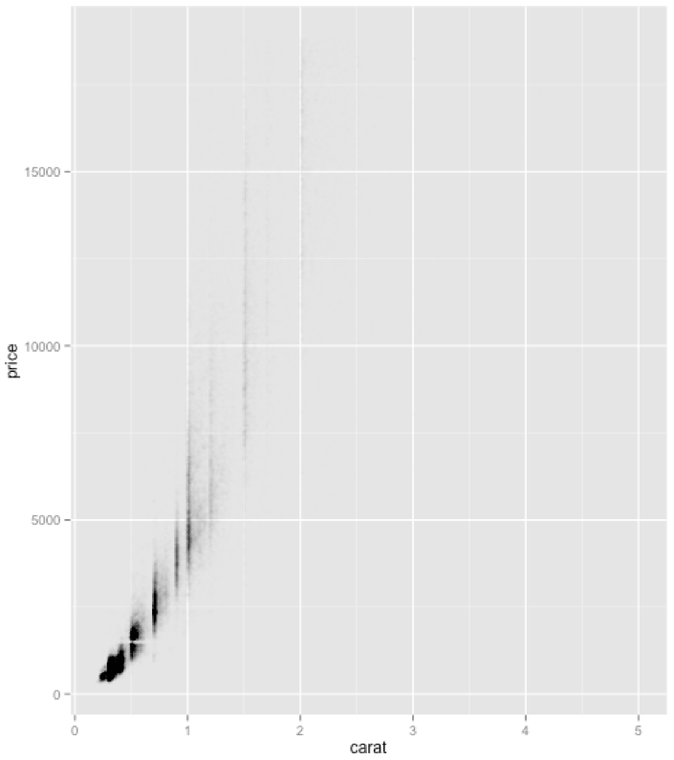
library(scales)
qplot(carat, price, data = diamonds, colour = I(alpha("black", 1/200)))
You can also manually set the aesthetics using I()

Slide 16
Plot geoms(1)
geom = "point" draws points to produce a scatterplot. This is the default when you supply both x and y arguments to qplot().
geom = "smooth" fits a smoother to the data and displays the smooth and its standard error
geom = "boxplot" produces a box and whisker plot to summarise the distribution of a set of points
geom = "path" and geom = "line" draw lines between the data points.
For continuous variables, geom = "histogram" draws a histogram, geom = "freqpoly" a frequency polygon, and geom = "density" creates a density plot
For discrete variables, geom = "bar" makes a barchart

Slide 17
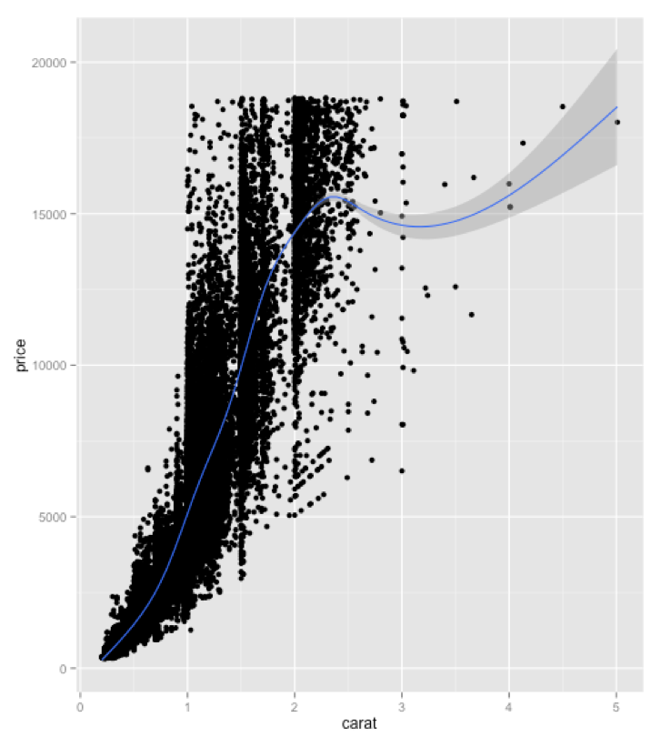
Plot geoms(2)
qplot(carat, price, data = diamonds, geom = c("point", "smooth"))

Slide 18
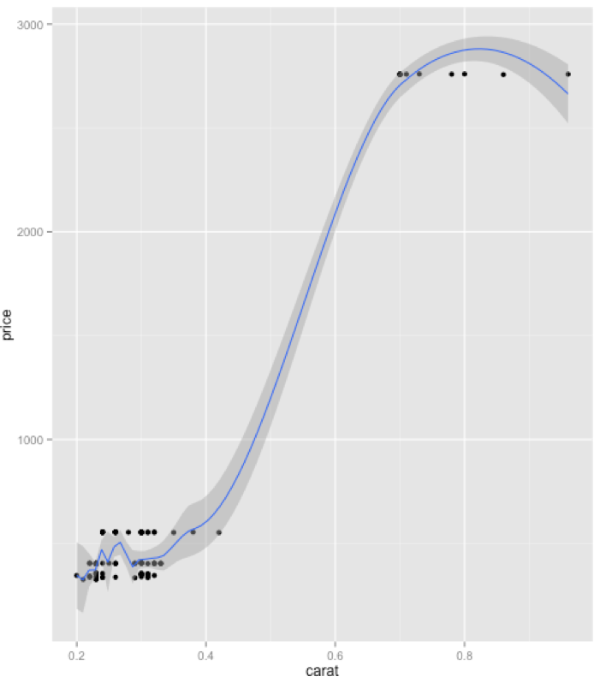
Plot geoms(3)
qplot(carat, price, data = diamonds[1:100,], geom = c("point", "smooth"),span=0.2,se=TRUE)
method = "loess", the default for small n, uses a smooth local regression.
If you want to turn the confidence interval off, use se = FALSE
The wiggliness of the line is controlled by the span parameter, which ranges from 0 (exceeding wiggly) to 1 (not so wiggly)

Slide 19
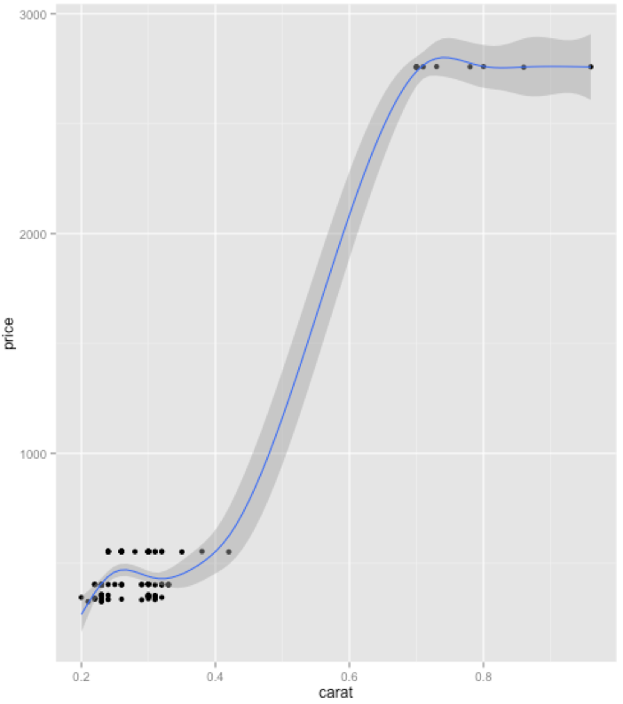
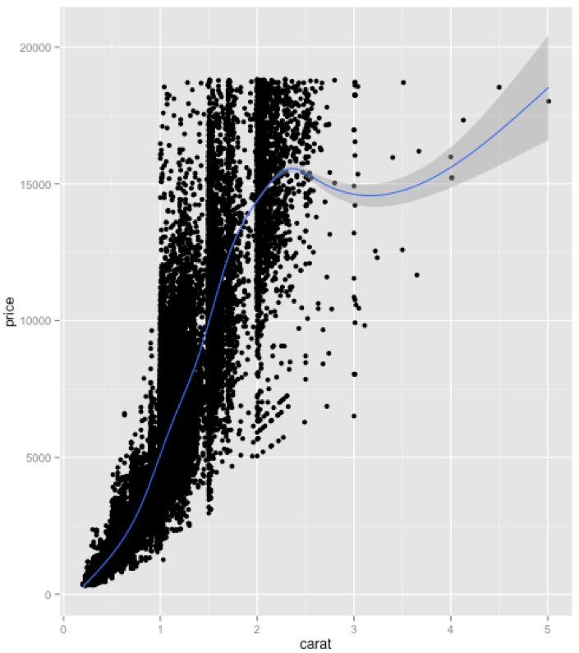
load the mgcv library and use method = "gam", formula = y ∼ s(x) to fit a generalised additive model. This is similar to using a spline with lm, but the degree of smoothness is estimated from the data. For large data, use the formula y ~ s(x, bs="cs"). This is used by default when there are more than 1,000 points.
library(mgcv)
qplot(carat, price, data = diamonds[1:100,], geom = c("point", "smooth"),method="gam", formula= y ~ s(x))
qplot(carat, price, data = diamonds, geom = c("point", "smooth"),method="gam", formula= y ~ s(x,bs="cs"))

Slide 20
Plog geom(5)
method = "lm" fits a linear model. The default will fit a straight line to your data, or you can specify formula = y ~ poly(x, 2) to specify a degree 2 polynomial, or better, load the splines package and use a natural spline: formula = y ~ ns(x, 2). The second parameter is the degrees of freedom: a higher number will create a wigglier curve.
method = "rlm" works like lm, but uses a robust fitting algorithm so that outliers don’t affect the fit as much
library(splines)
qplot(carat, price, data = diamonds[1:100,], geom=c("point", "smooth"), method = "lm")
qplot(carat, price, data = diamonds[1:100,], geom=c("point", "smooth"), method = "lm", formula=y ~ poly(x,2))
qplot(carat, price, data = diamonds[1:100,], geom=c("point", "smooth"), method = "lm", formula=y ~ ns(x,3))
library(MASS)
qplot(carat, price, data = diamonds[1:100,], geom=c("point", "smooth"), method = "rlm")

Slide 21
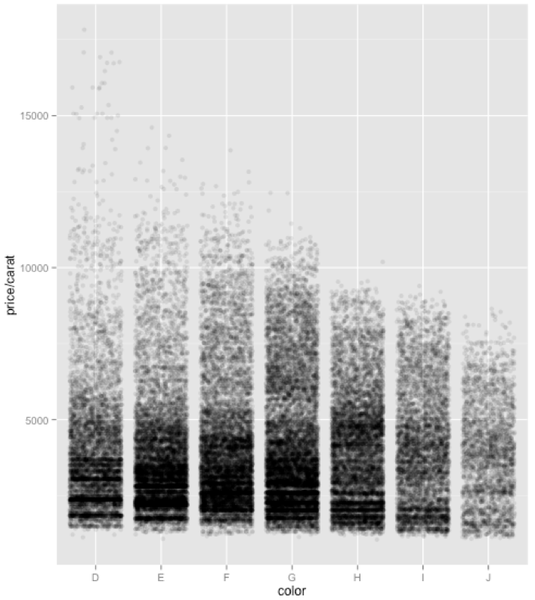
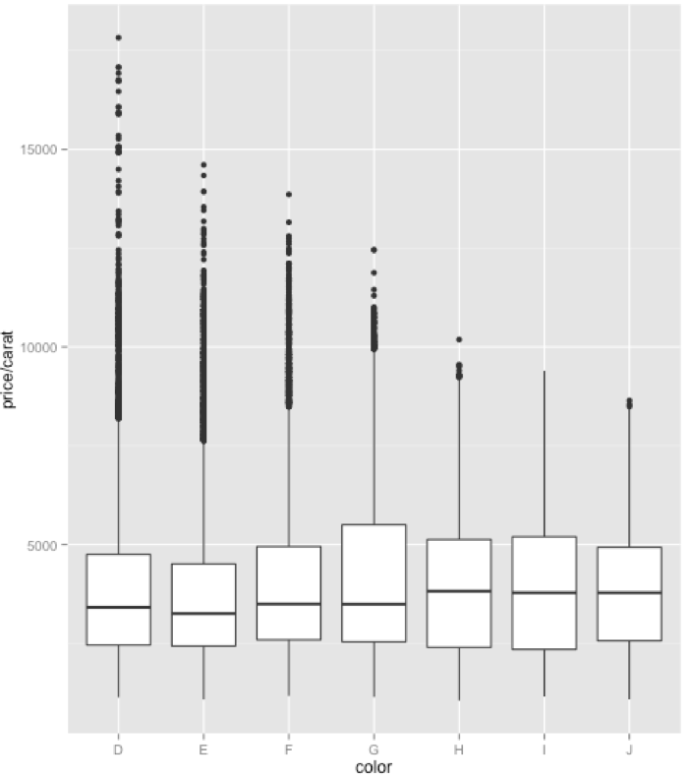
Boxplots and jittered points
qplot(color, price / carat, data = diamonds, geom = "jitter", colour = I(alpha("black", 1 / 10)))
qplot(color, price / carat, data = diamonds, geom = "boxplot")

Slide 22
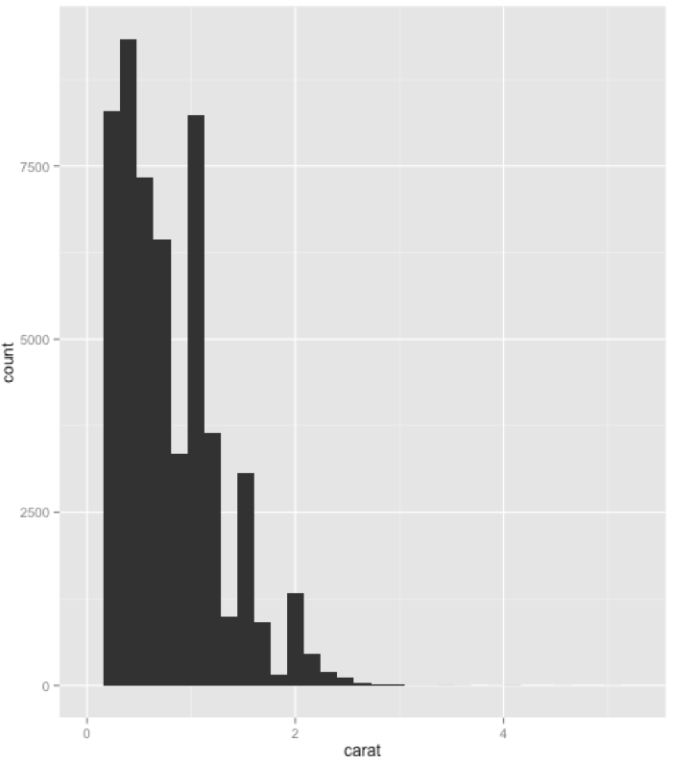
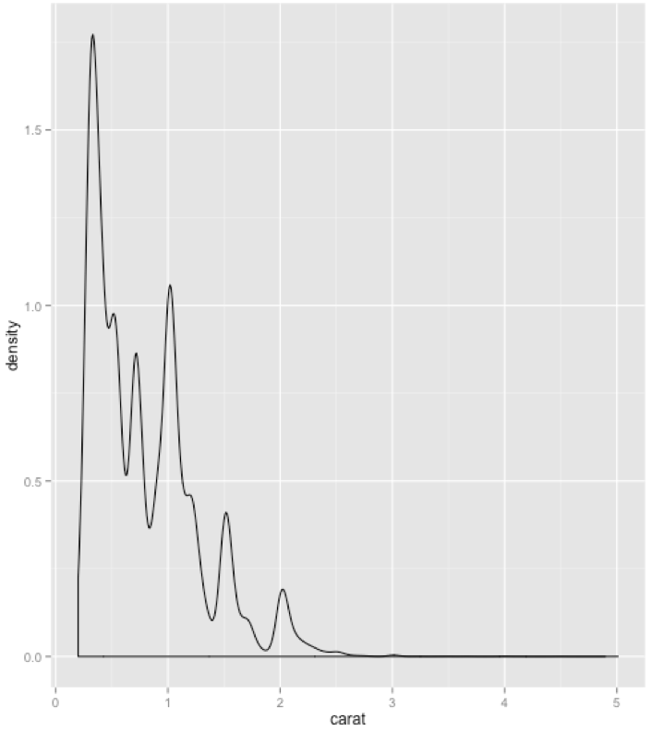
Histogram and density plots(1)
qplot(carat, data = diamonds, geom = "histogram")
qplot(carat, data = diamonds, geom = "density")

Slide 23
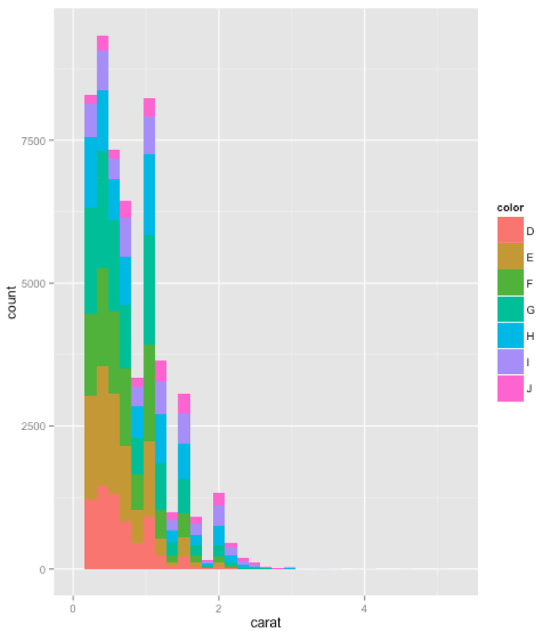
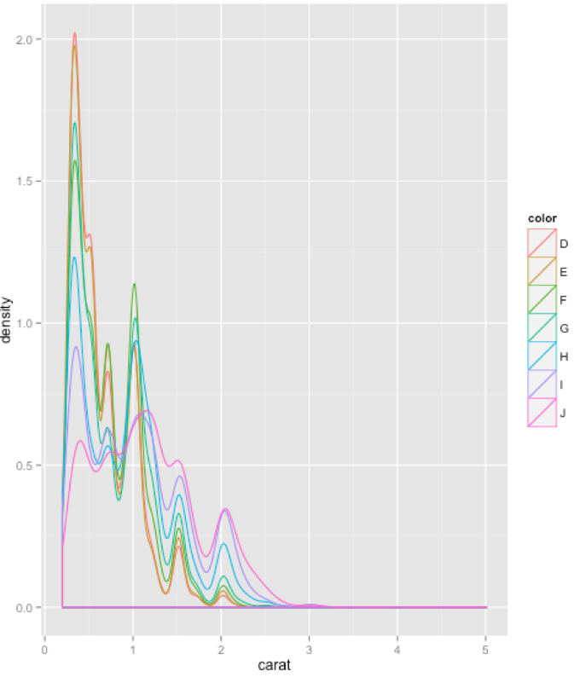
Histogram and density plots(2)
qplot(carat, data = diamonds, geom = "histogram", fill = color)
qplot(carat, data = diamonds, geom = "density", colour = color)

Slide 24
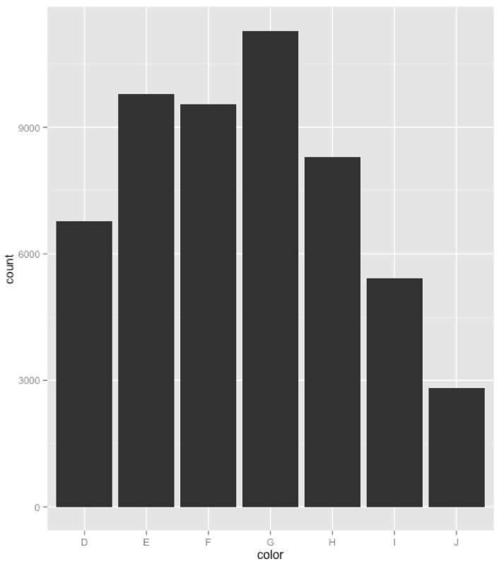
Bar charts(1)
qplot(color, data=diamonds, geom="bar")
> dim(diamonds[diamonds$color=="D",])
[1] 6775 10
> dim(diamonds[diamonds$color=="E",])
[1] 9797 10
> dim(diamonds[diamonds$color=="E",])
[1] 9797 10
> dim(diamonds[diamonds$color=="F",])
[1] 9542 10
> dim(diamonds[diamonds$color=="G",])
[1] 11292 10
> dim(diamonds[diamonds$color=="H",])
[1] 8304 10
> dim(diamonds[diamonds$color=="I",])
[1] 5422 10
> dim(diamonds[diamonds$color=="J",])
[1] 2808 10

Slide 25
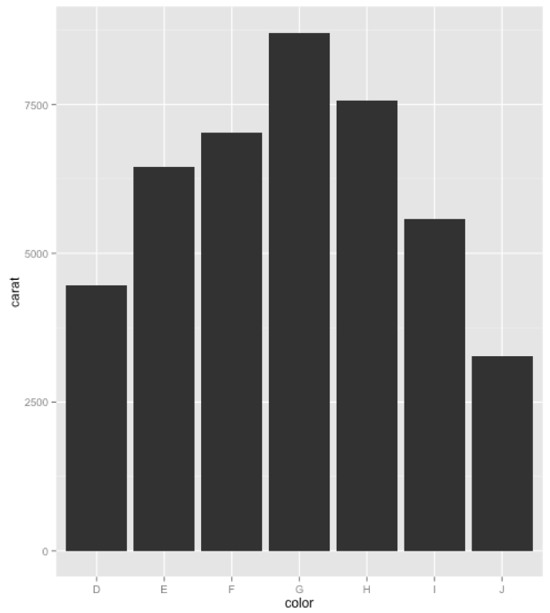
Bar charts(2)
qplot(color, data = diamonds, geom = "bar", weight = carat)+ scale_y_continuous("carat")
> sum(diamonds[diamonds$color=="D", "carat"])
[1] 4456.56
> sum(diamonds[diamonds$color=="E", "carat"])
[1] 6445.12
> sum(diamonds[diamonds$color=="F", "carat"])
[1] 7028.05
> sum(diamonds[diamonds$color=="G", "carat"])
[1] 8708.28
> sum(diamonds[diamonds$color=="H", "carat"])
[1] 7571.58
> sum(diamonds[diamonds$color=="I", "carat"])
[1] 5568
> sum(diamonds[diamonds$color=="J", "carat"])
[1] 3263.28

Slide 26
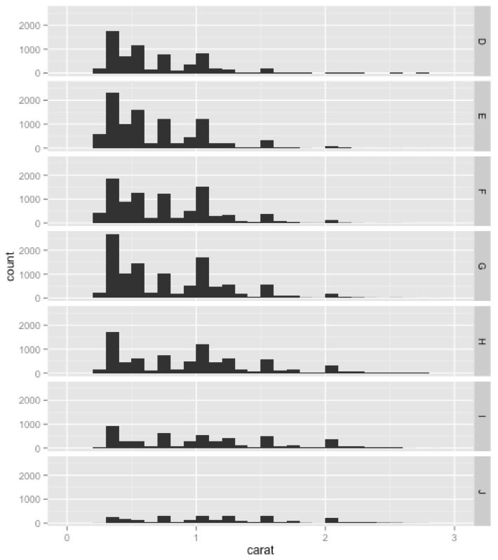
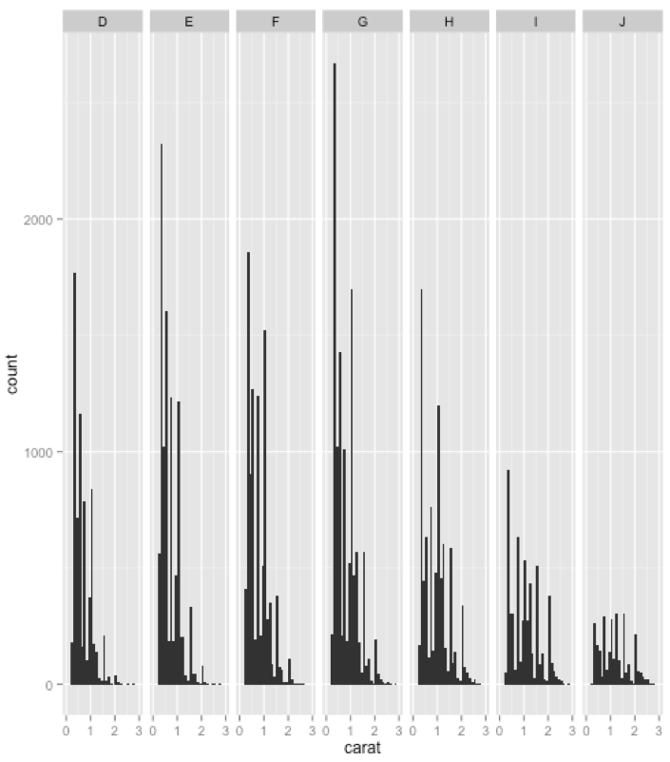
Faceting(1)
qplot(carat, data = diamonds, facets = color ~ ., geom = "histogram", binwidth = 0.1, xlim = c(0, 3))
qplot(carat, data = diamonds, facets = . ~ color, geom = "histogram", binwidth = 0.1, xlim = c(0, 3))
arranged on a grid specified by a faceting formula which looks like row var ∼ col var

Slide 27
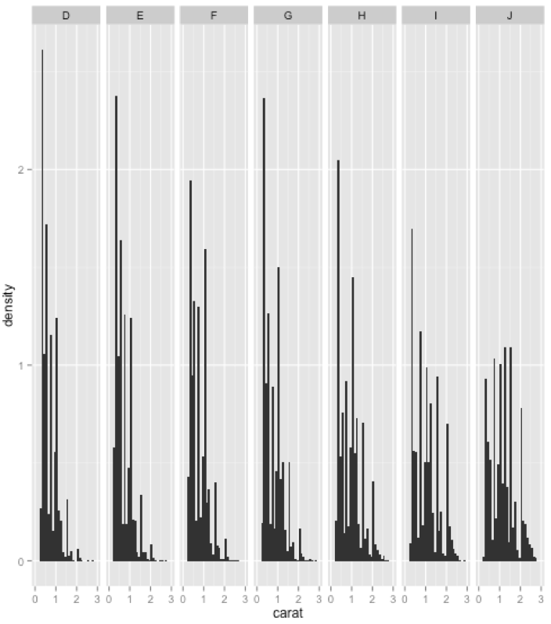
Faceting(2)
qplot(carat,..density.., data = diamonds, facets = . ~ color, geom = "histogram", binwidth = 0.1, xlim = c(0, 3))
The ..density.. syntax is new. The y-axis of the histogram does not come from the original data, but from the statistical transformation that counts the number of observations in each bin. Using ..density.. tells ggplot2 to map the density to the y-axis instead of the default use of count.

Slide 28
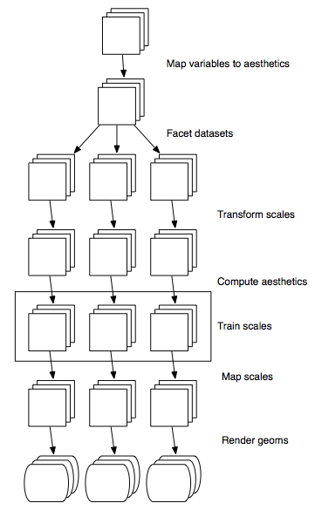
Plot generation process
Each square represents a layer, and this schematic represents a plot with three layers and three panels.
All steps work by transforming individual data frames, except for training scales which doesn’t affect the data frame and operates across all datasets simultaneously.

Slide 29
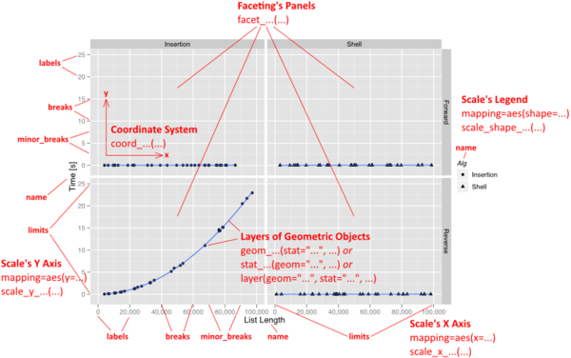

Slide 30
Layers
Plots can be created in two ways: all at once with qplot(), as shown previously
or piece-by-piece with ggplot() and layer functions
> p<-qplot(carat, price, data = diamonds[1:50,], colour = color)
> summary(p)
data: carat, cut, color, clarity, depth, table, price, x, y, z [50x10]
mapping: colour = color, x = carat, y = price
faceting: facet_null()
-----------------------------------
geom_point:
stat_identity:
position_identity: (width = NULL, height = NULL)

Slide 31
Creating plot(1)
To create the plot object ourselves, we use ggplot().
This has two arguments: data and aesthetic mapping. These arguments set up defaults for the plot and can be omitted if you specify data and aesthetics when adding each layer.
This plot cannot be displayed until we add a layer
p <- ggplot(diamonds, aes(carat, price, colour = cut))
p <- p + layer(geom = "point")
p

Slide 32
Creating plot(2)
Layer uses the plot defaults for data and aesthetic mapping and it uses default values for two optional arguments: the statistical transformation (the stat) and the position adjustment. A more fully specified layer can take any or all of these arguments:
layer(geom, geom_params, stat, stat_params, data, mapping, position)

Slide 33
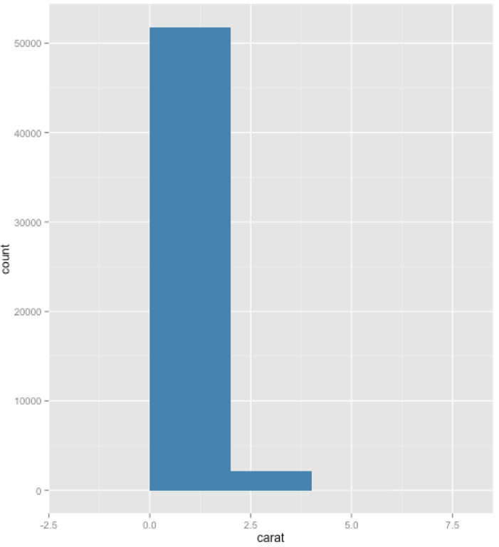
Creating plot(3)
p <- ggplot(diamonds, aes(x = carat))
p <- p + layer(
geom = "bar",
geom_params = list(fill = "steelblue"),
stat = "bin",
stat_params = list(binwidth = 2)
)
p
^{Simplify} it by using shortcuts: every geom is
associated with a default statistic and position, and
every statistic with a default geom.
Only need to specify one of stat or geom to get a completely specified layer, with parameters passed on to the geom or stat as appropriate.
geom_histogram(binwidth = 2, fill = "steelblue")

Slide 34
Creating plot(4)
geom_XXX(mapping, data, ..., geom, position)
stat_XXX(mapping, data, ..., stat, position)
mapping (optional): A set of aesthetic mappings, specified using the aes() function and combined with the plot defaults
data (optional): A data set which overrides the default plot data set.
... : Parameters for the geom or stat, such as bin width in the histogram or bandwidth for a loess smoother.
geom or stat (optional): You can override the default stat for a geom, or the default geom for a stat.
position (optional): Choose a method for adjusting overlapping objects

Slide 35
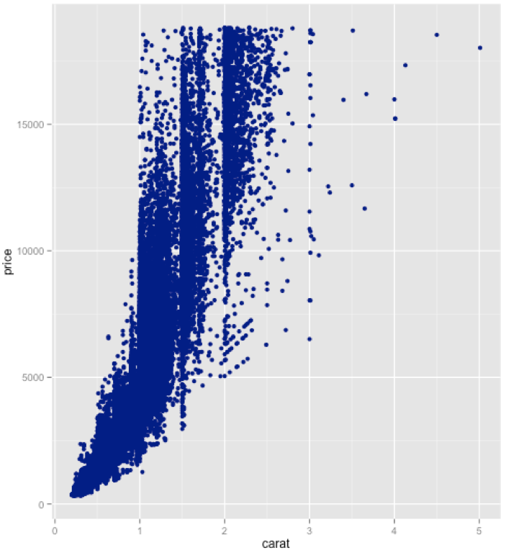
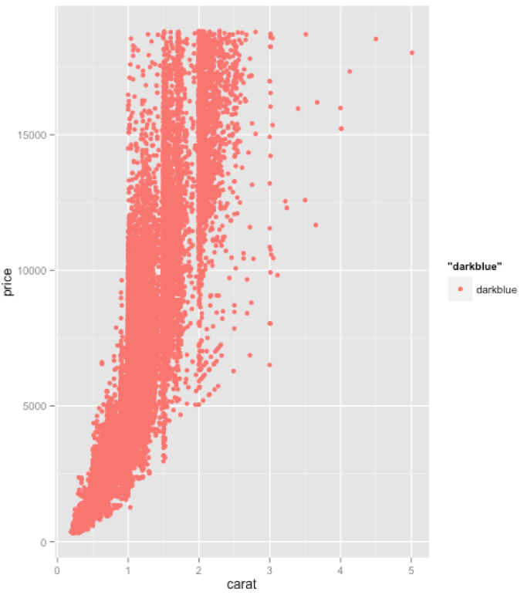
Creating plot(5)
p<-ggplot(diamonds,aes(carat,price))+geom_point(colour="darkblue")
p
p<-ggplot(diamonds,aes(carat,price))+geom_point(aes(colour="darkblue"))
p
This maps DOES NOT SET the colour to the value “darkblue”. It creates a new variable containing only the value “darkblue” and then maps colour to that new variable. Because this value is discrete, the default colour scale uses evenly spaced colours on the colour wheel, and since there is only one value this colour is pinkish.

Slide 36
Creating plot(6): Grouping
geoms can be individual and collective geoms
By default, group is set to the interaction of all discrete variables in the plot
When it doesn’t, explicitly define the grouping structure, by mapping group to a variable that has a different value for each group
interaction() is useful if a single pre-existing variable doesn’t cleanly separate groups

Slide 37
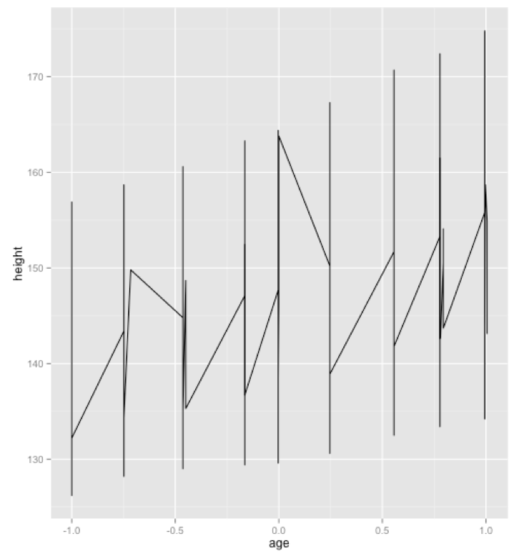
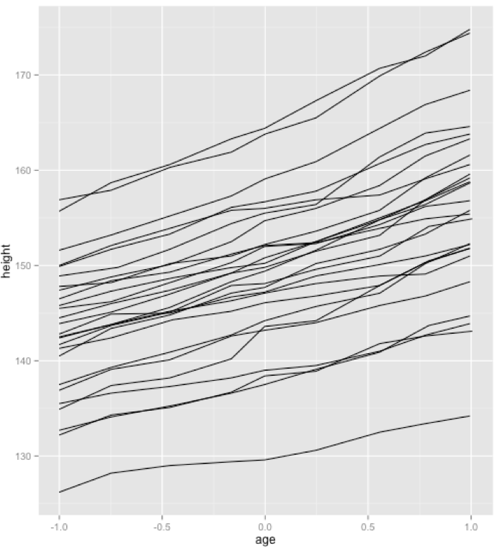
Creating plot(7): Grouping
>head(Oxboys)
Grouped Data: height ~ age | Subject
Subject age height Occasion
1 1 -1.0000 140.5 1
2 1 -0.7479 143.4 2
3 1 -0.4630 144.8 3
4 1 -0.1643 147.1 4
5 1 -0.0027 147.7 5
6 1 0.2466 150.2 6
p <- ggplot(Oxboys, aes(age, height)) + geom_line()
p
p <- ggplot(Oxboys, aes(age, height, group = Subject)) + geom_line()
p

Slide 38
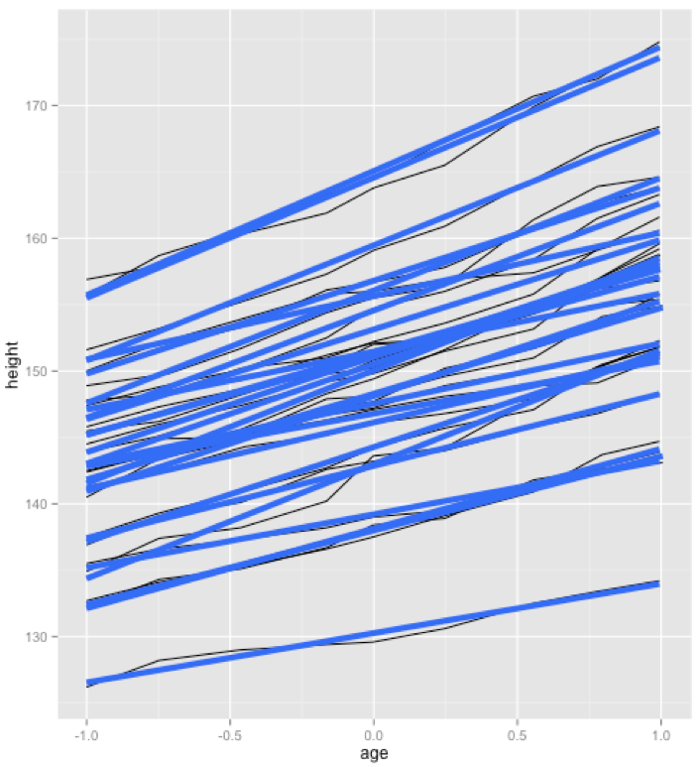
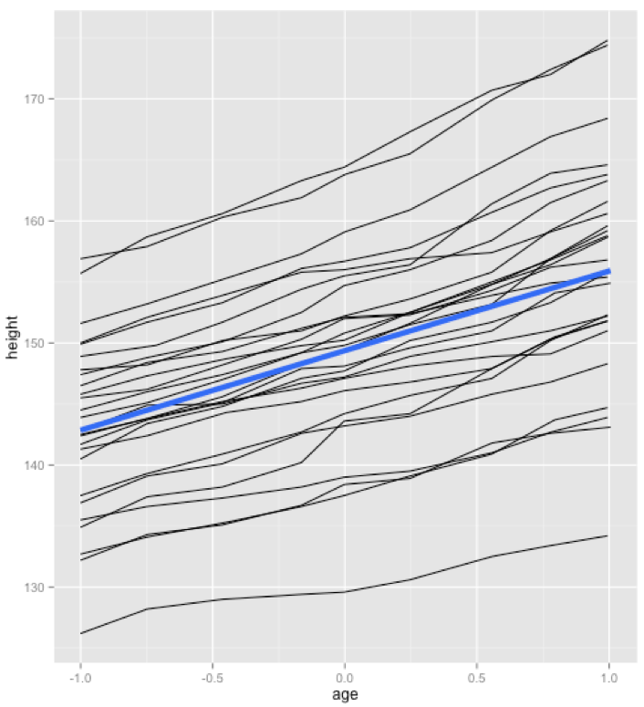
Creating plot(8): Grouping
p <- ggplot(Oxboys, aes(age, height, group = Subject)) + geom_line()
p + geom_smooth(method="lm", size=2, se=F)
p <- ggplot(Oxboys, aes(age, height, group = Subject)) + geom_line()
p + geom_smooth(aes(group=“dummy”),method="lm", size=2, se=F)

Slide 39
Geoms
Geometric objects (geoms)
  Perform the actual rendering of the layer
  Control the type of plot that you create
  Has a set of aesthetics
  Differ in the way they are parameterised
  Have a default statistic

Slide 40
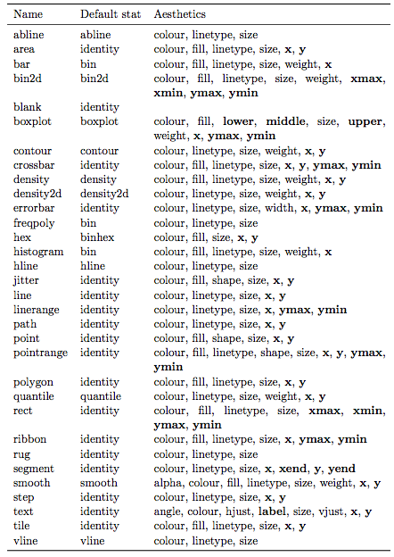
Default statistics and aesthetics. Emboldened aesthetics are required

Slide 41
Stat(1)
Statistical transformation (stat)
  Transforms the data by summarising it in some manner
  e.g., smoother calculates the mean of y, condition of x
  A stat must be location-scale invariant (transformation stays same when scale is changed)
  f(x+a)=f(x)+a ; f(b.x)=b.f(x)
  Takes a dataset as input, returns a dataset as output and introduces new variables
  e.g., stat_bin (statistic used to make histograms, produces)
    count: number of observation in each bin
    density: density of observation in each bin (percentage of total/bar width)
    x: the centre of bin
  The names of generated variables must be surrounded with .. when used

Slide 42
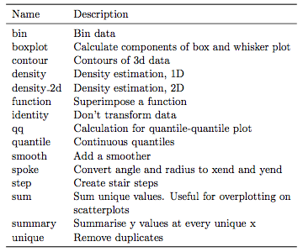
Stat(2)

Slide 43
Position adjustments(1)
Apply minor tweaks to the position of elements within a layer
Normally used with discrete data
Continuous data typically don’t overlap and when do, jittering is sufficient

Slide 44
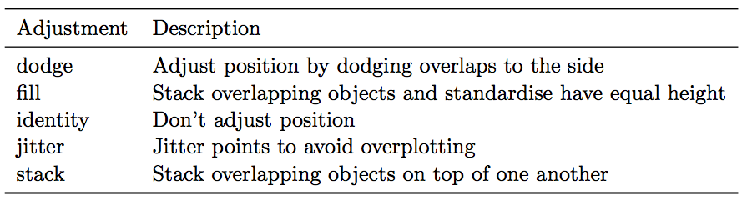
Position adjustments(2)

Slide 45
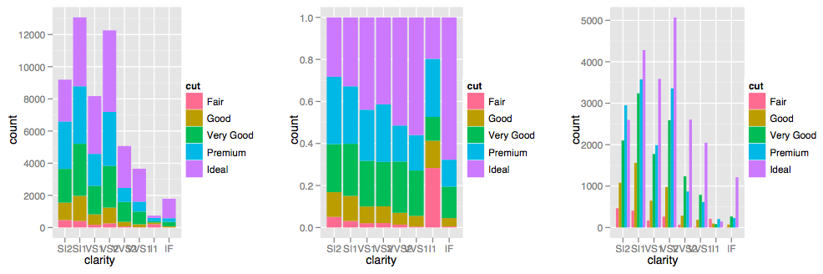
Position adjustments(3)
stacking
filling
dodging

Slide 46
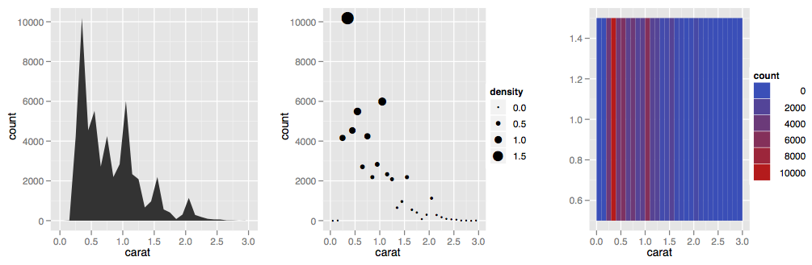
Position adjustments(4)
d <- ggplot(diamonds, aes(carat)) + xlim(0, 3)
d + stat_bin(aes(ymax = ..count..), binwidth = 0.1, geom = "area")
d + stat_bin(
aes(size = ..density..), binwidth = 0.1,
geom = "point", position="identity”)
d + stat_bin(
aes(y = 1, fill = ..count..), binwidth = 0.1,
geom = "tile", position="identity”)

Slide 47
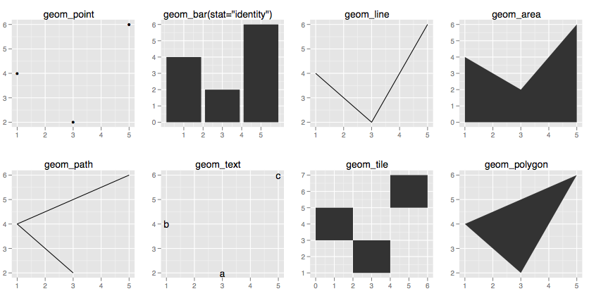
df <- data.frame(x = c(3, 1, 5), y = c(2, 4, 6), label = c("a","b","c"))
p <- ggplot(df, aes(x, y, label = label)) + xlab(NULL) + ylab(NULL)
p + geom_point() + ggtitle("geom_point")
p + geom_bar(stat="identity") +ggtitle("geom_bar(stat=\"identity\")")
p + geom_line() + ggtitle("geom_line")
p + geom_area() + ggtitle("geom_area")
p + geom_path() + ggtitle("geom_path")
p + geom_text() + ggtitle("geom_text")
p + geom_tile() + ggtitle("geom_tile")
p + geom_polygon() + ggtitle("geom_polygon")

Slide 48
Scales, axes and legends(1)
Scales control the mapping from data to aesthetics
Data → size, colour, position or shape
data space (domain) → scale → aesthetic space (range)
Process of scaling: Transformation (log transformation?), Training (minimum?maximum? Of a continuous variable; unique levels? of a categorical variable), and Mapping
Four categories:
  position scales
  colour scales
  manual discrete scales
  identity scales
guide: perform the inverse mapping from aesthetic space to data space
  For position aesthetics, axes are the guides
  Any other aesthetics, legends are the guides
Every aesthetic has a default scale: set_default_scale()

Slide 49
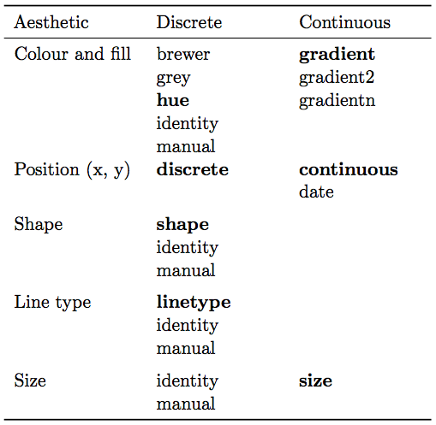
Scales, axes and legends(2)
All scale constructors start with scale_
Followed by the name of the aesthetic (e.g., colour_, shape_, or x_)
Finally name of the scale (e.g., gradient, hue, or manual),
E.g., scale_colour_hue(), scale_fill_brewer()

Slide 50
Scale example

Slide 51
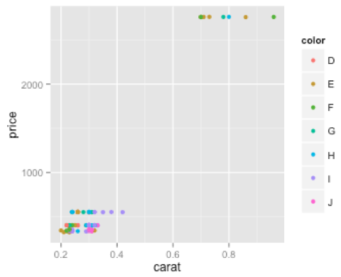
qplot(carat, price, data = diamonds[1:100,], colour = color)

Slide 52
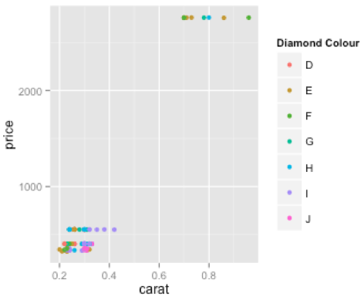
qplot(carat, price, data = diamonds[1:100,], colour = color) + scale_color_hue("Diamond Colour")

Slide 53
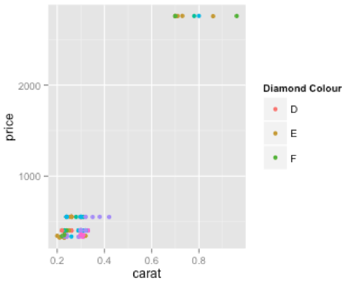
qplot(carat, price, data = diamonds[1:100,], colour = color) +
scale_color_hue("Diamond Colour", breaks=c("D","E","F"))

Slide 54
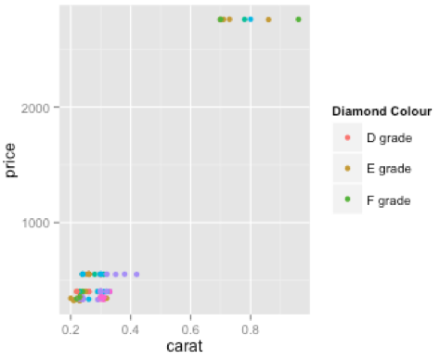
qplot(carat, price, data = diamonds[1:100,], colour = color) +
scale_color_hue("Diamond Colour", breaks=c("D","E","F"), labels=c("D grade","E grade","F grade"))

Slide 55
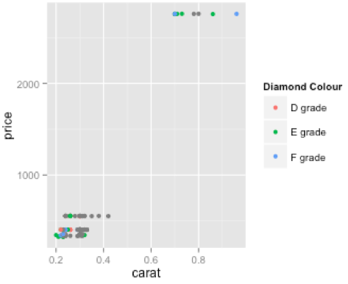
qplot(carat, price, data = diamonds[1:100,], colour = color) +
scale_color_hue("Diamond Colour", limits=c("D","E","F"), labels=c("D grade","E grade","F grade"))

Slide 56
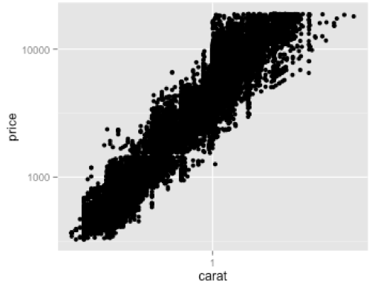
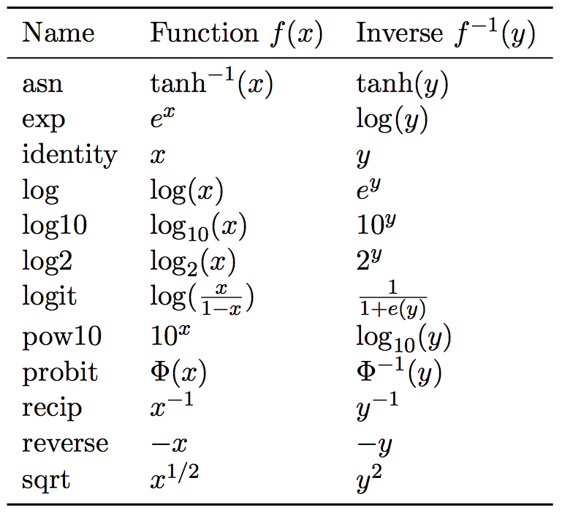
Continuous scales(1)
qplot(log10(carat), log10(price), data = diamonds)
qplot(carat, price, data = diamonds) + scale_x_log10() + scale_y_log10()
qplot(carat, price, data = diamonds) + scale_x_continuous(trans="log10") + scale_y_log10()

Slide 57
Continuous scales(2)
scale_colour_gradient() and scale_fill_gradient(): a two–colour gradient, low–high. Arguments low and high control the colours at either end of the gradient.
scale_colour_gradient2() and scale_fill_gradient2(): a three–colour gradient, low–med–high.
scale_colour_gradientn() and scale_fill_gradientn(): a custom n–colour gra- dient.

Slide 58
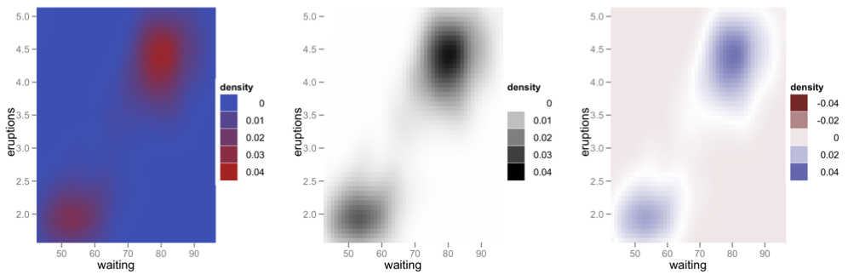
Continuous scales(3)
f2d <- with(faithful, MASS::kde2d(eruptions, waiting, h = c(1, 10), n = 50))
df <- with(f2d, cbind(expand.grid(x, y), as.vector(z)))
names(df) <- c("eruptions", "waiting", "density")
erupt <- ggplot(df, aes(waiting, eruptions, fill = density)) +
geom_tile() +
scale_x_continuous(expand = c(0, 0)) +
scale_y_continuous(expand = c(0, 0))
erupt + scale_fill_gradient(limits = c(0, 0.04))
erupt + scale_fill_gradient(limits = c(0, 0.04), low="white", high="black")
erupt + scale_fill_gradient2(limits = c(-0.04, 0.04),midpoint = mean(df$density))

Slide 59
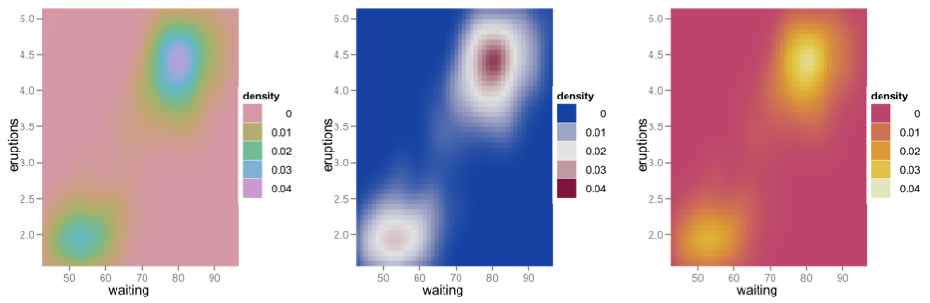
Continuous scales(4)
library(colorspace)
fill_gradn <- function(pal) {
scale_fill_gradientn(colours = pal(7), limits = c(0, 0.04))
}
erupt + fill_gradn(rainbow_hcl)
erupt + fill_gradn(diverge_hcl)
erupt + fill_gradn(heat_hcl)

